Slide 1


Data Structures in Everyday Life

Slide 2

COURSE and FACULTY DETAILS
Course Title : Theory of Computation
Course Code : CSE228
Faculty Details
Shah Md. Tanvir Siddique
Assistant Professor
Department of CSE
Daffodil International University

Slide 3
Team Members and Contents
Name : S.M. Sadman Al Siam Name: Md. Sazzadul Islam Shaon
ID : 0242310005101195 ID : 0242310005101028
Topic : Introduction Topic : Array + Linked List
Name :Meheruba Binte Kashem Anti Name : Tasmia Tarannum Silme Name : Md. Hasib Hossain
ID : 0242310005101157 ID : 0242310005101090 ID : 0242310005101195
Topic : Stack + Queue Topic : Tree Topic : Graph + Conclusion

Slide 4
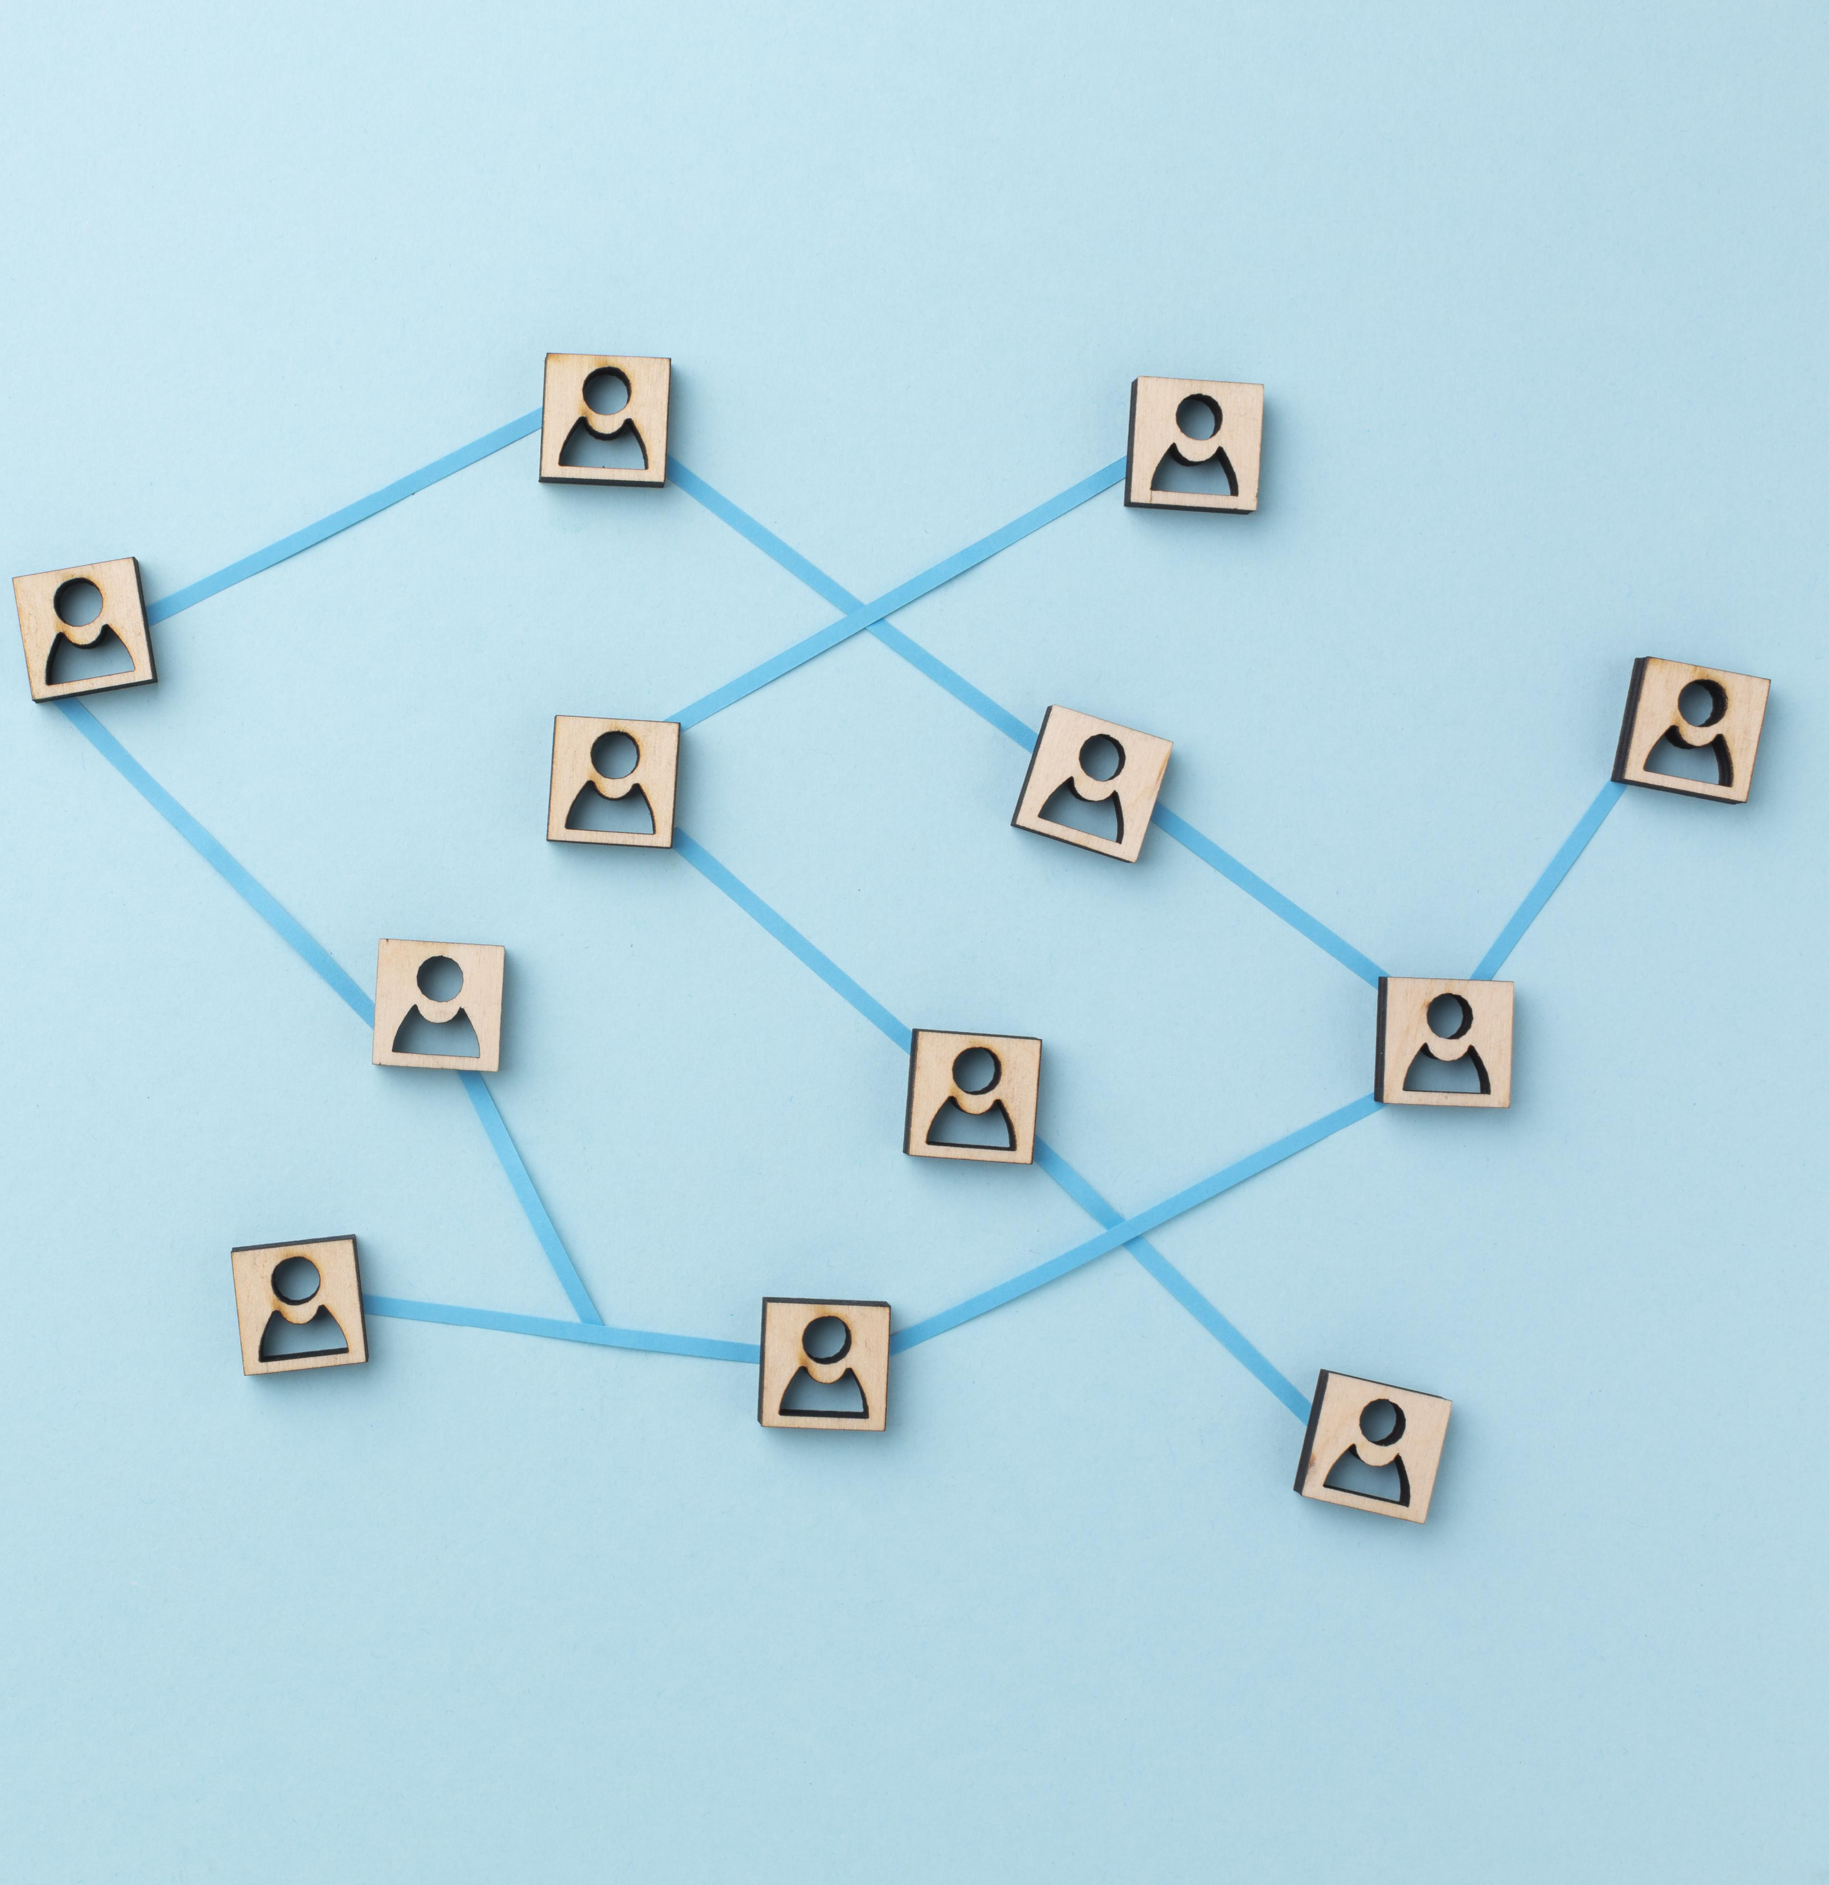
What are Data Structures ?
Data structures are ways of organizing and storing data so that it can be accessed and modified efficiently.
Types of Data Structures:
Arrays
Linked Lists
Stacks
Queues
Trees
Graphs
Hash Maps

Slide 5


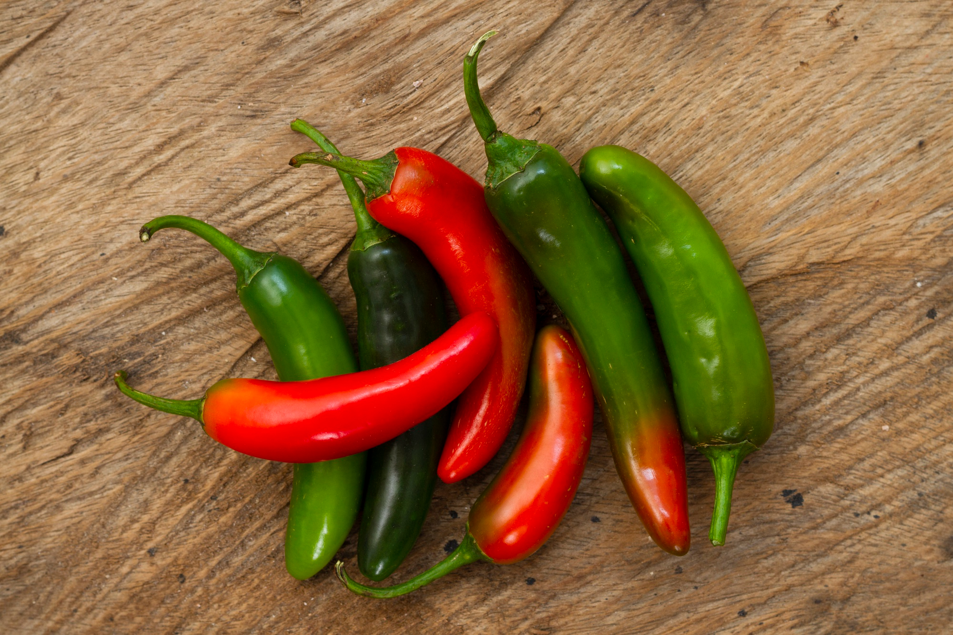
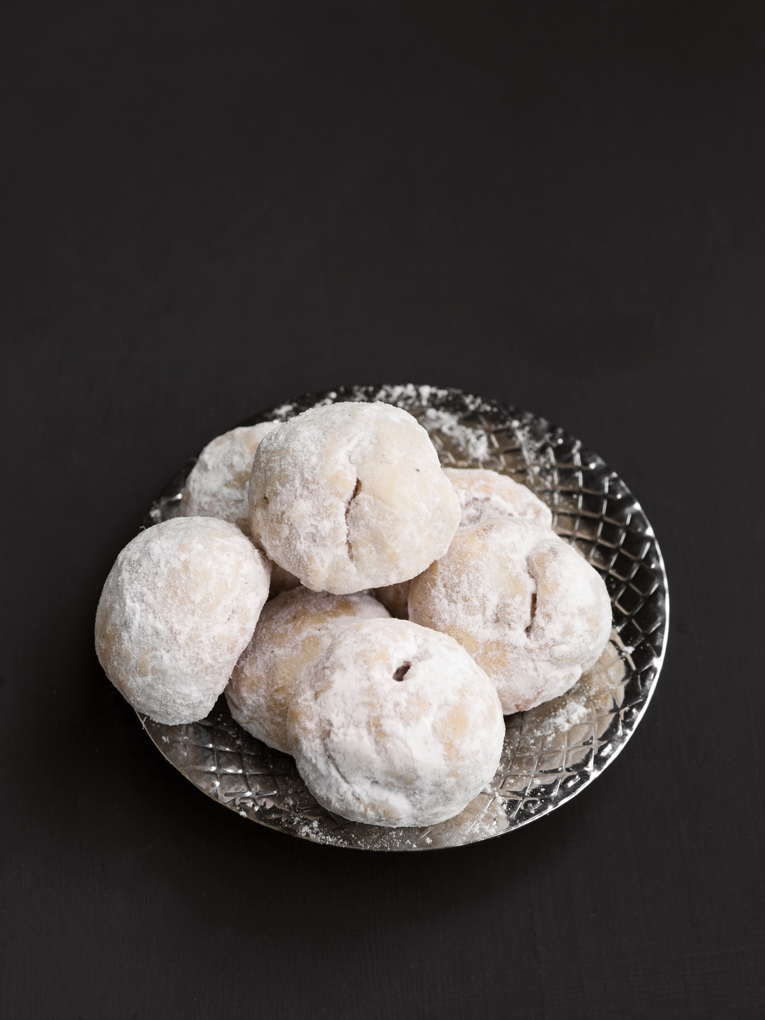
Arrays in Everyday Life
Example: The Grocery List Dilemma
Picture this: You're at New Market, and you’ve got a list of things to buy—atta, eggs, chilis, and that special mishti your mom loves. This list is an array—each item has its place, just like your hopes of buying everything within budget.
Arrays = Organized Chaos
Fixed size: The same way your wallet has a limit.
Fast access: Like how you know exactly where the mishti shops are!

Slide 6
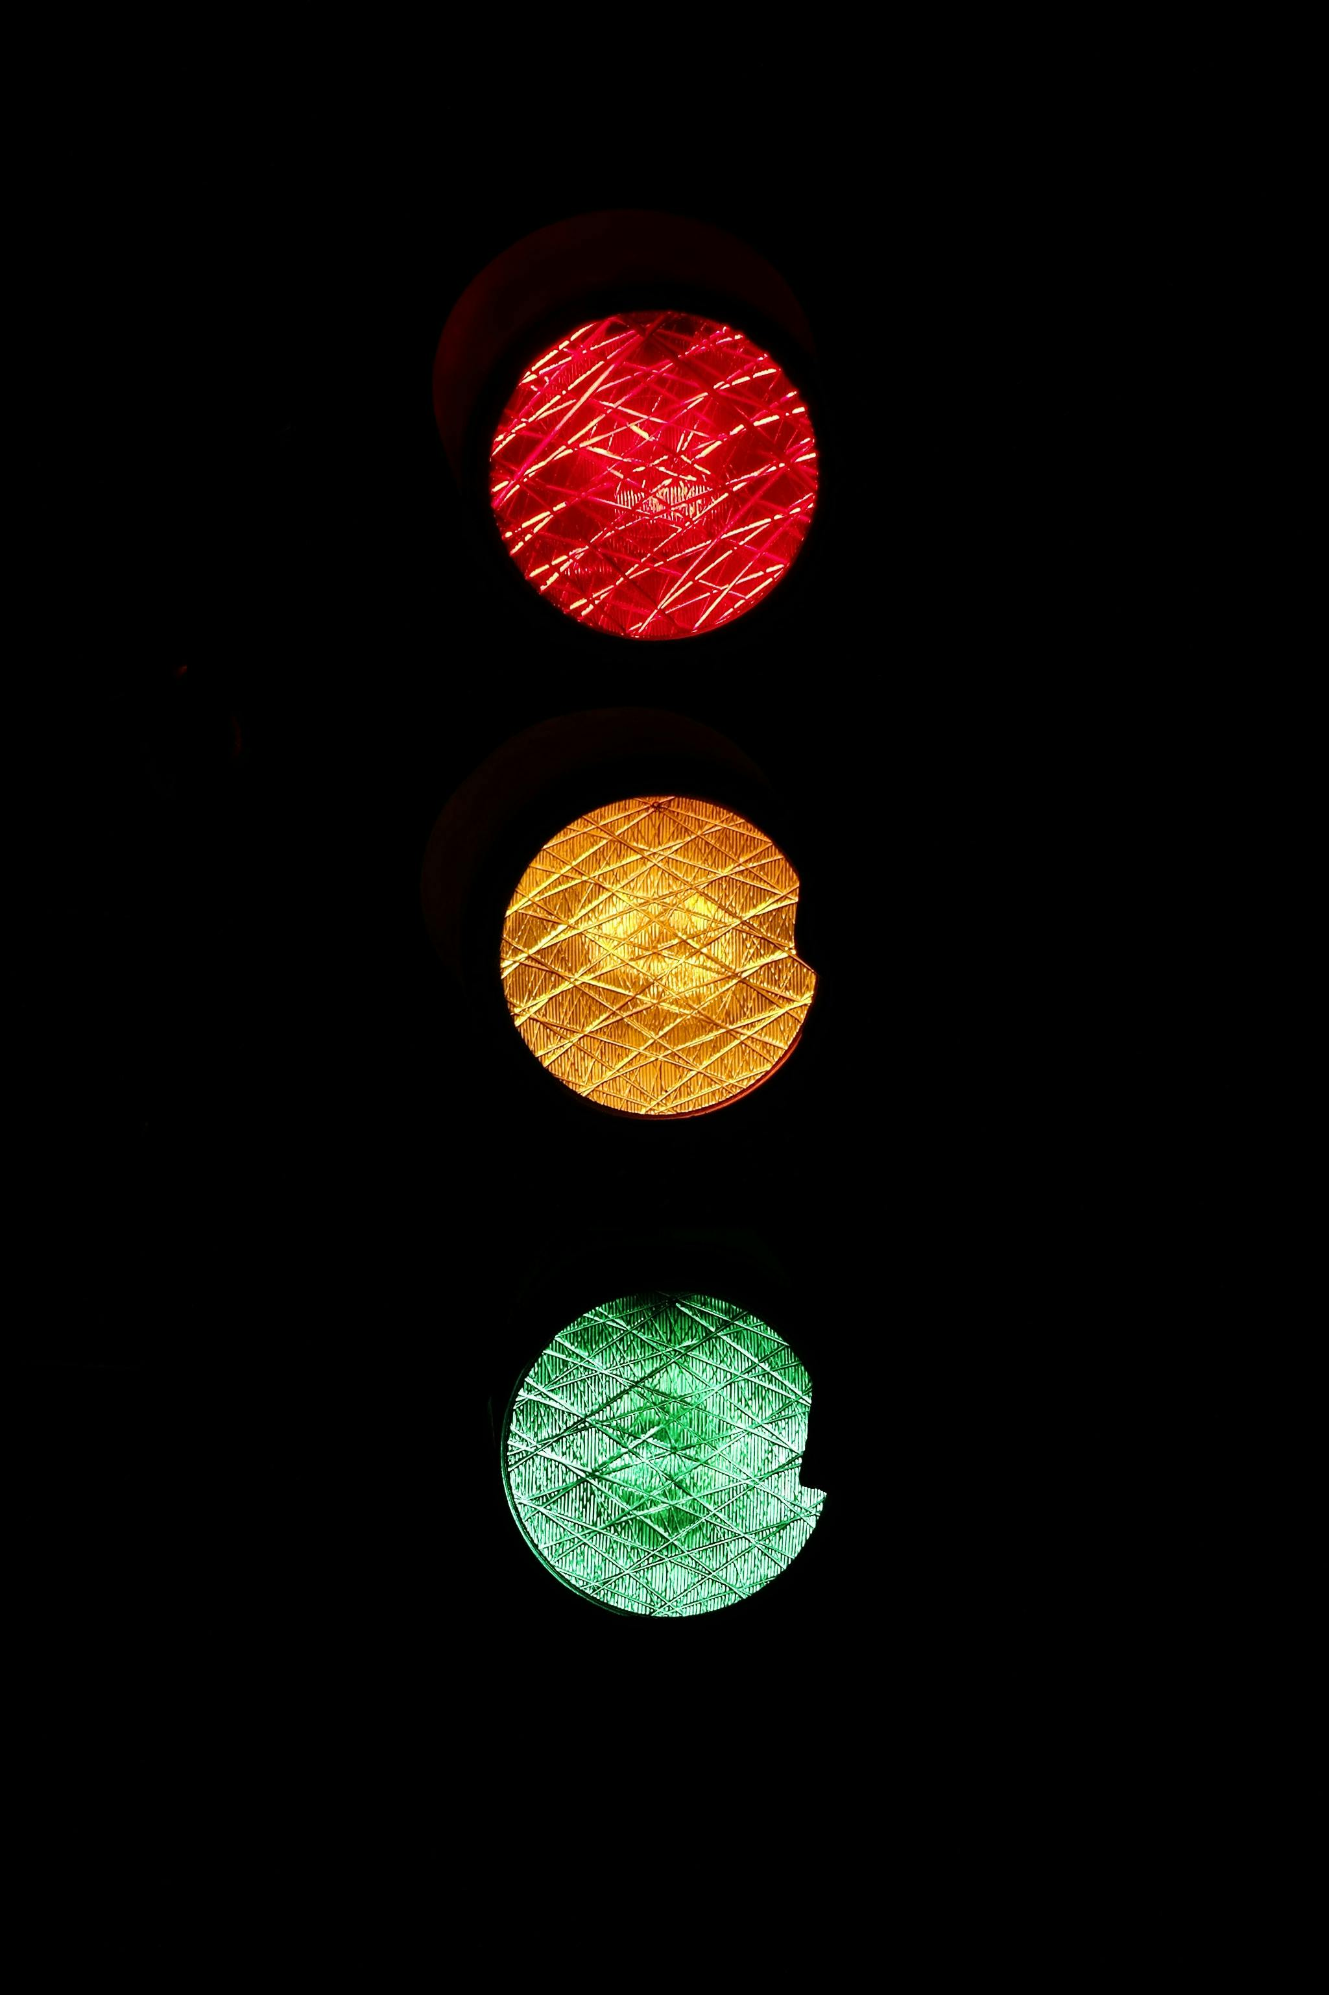
Linked Lists in Your Day
Example: Dhaka Traffic Adventures
Picture the journey from Mirpur to Dhanmondi. You hit one signal, then another, then another—each signal is linked to the next, making your commute feel like a never-ending linked list.
Why Linked Lists?
Dynamic size: You never know how many signals or stops you’ll hit.
Easy to insert or remove: Just like how you “suddenly” find a new shortcut that makes you feel like a genius.

Slide 7
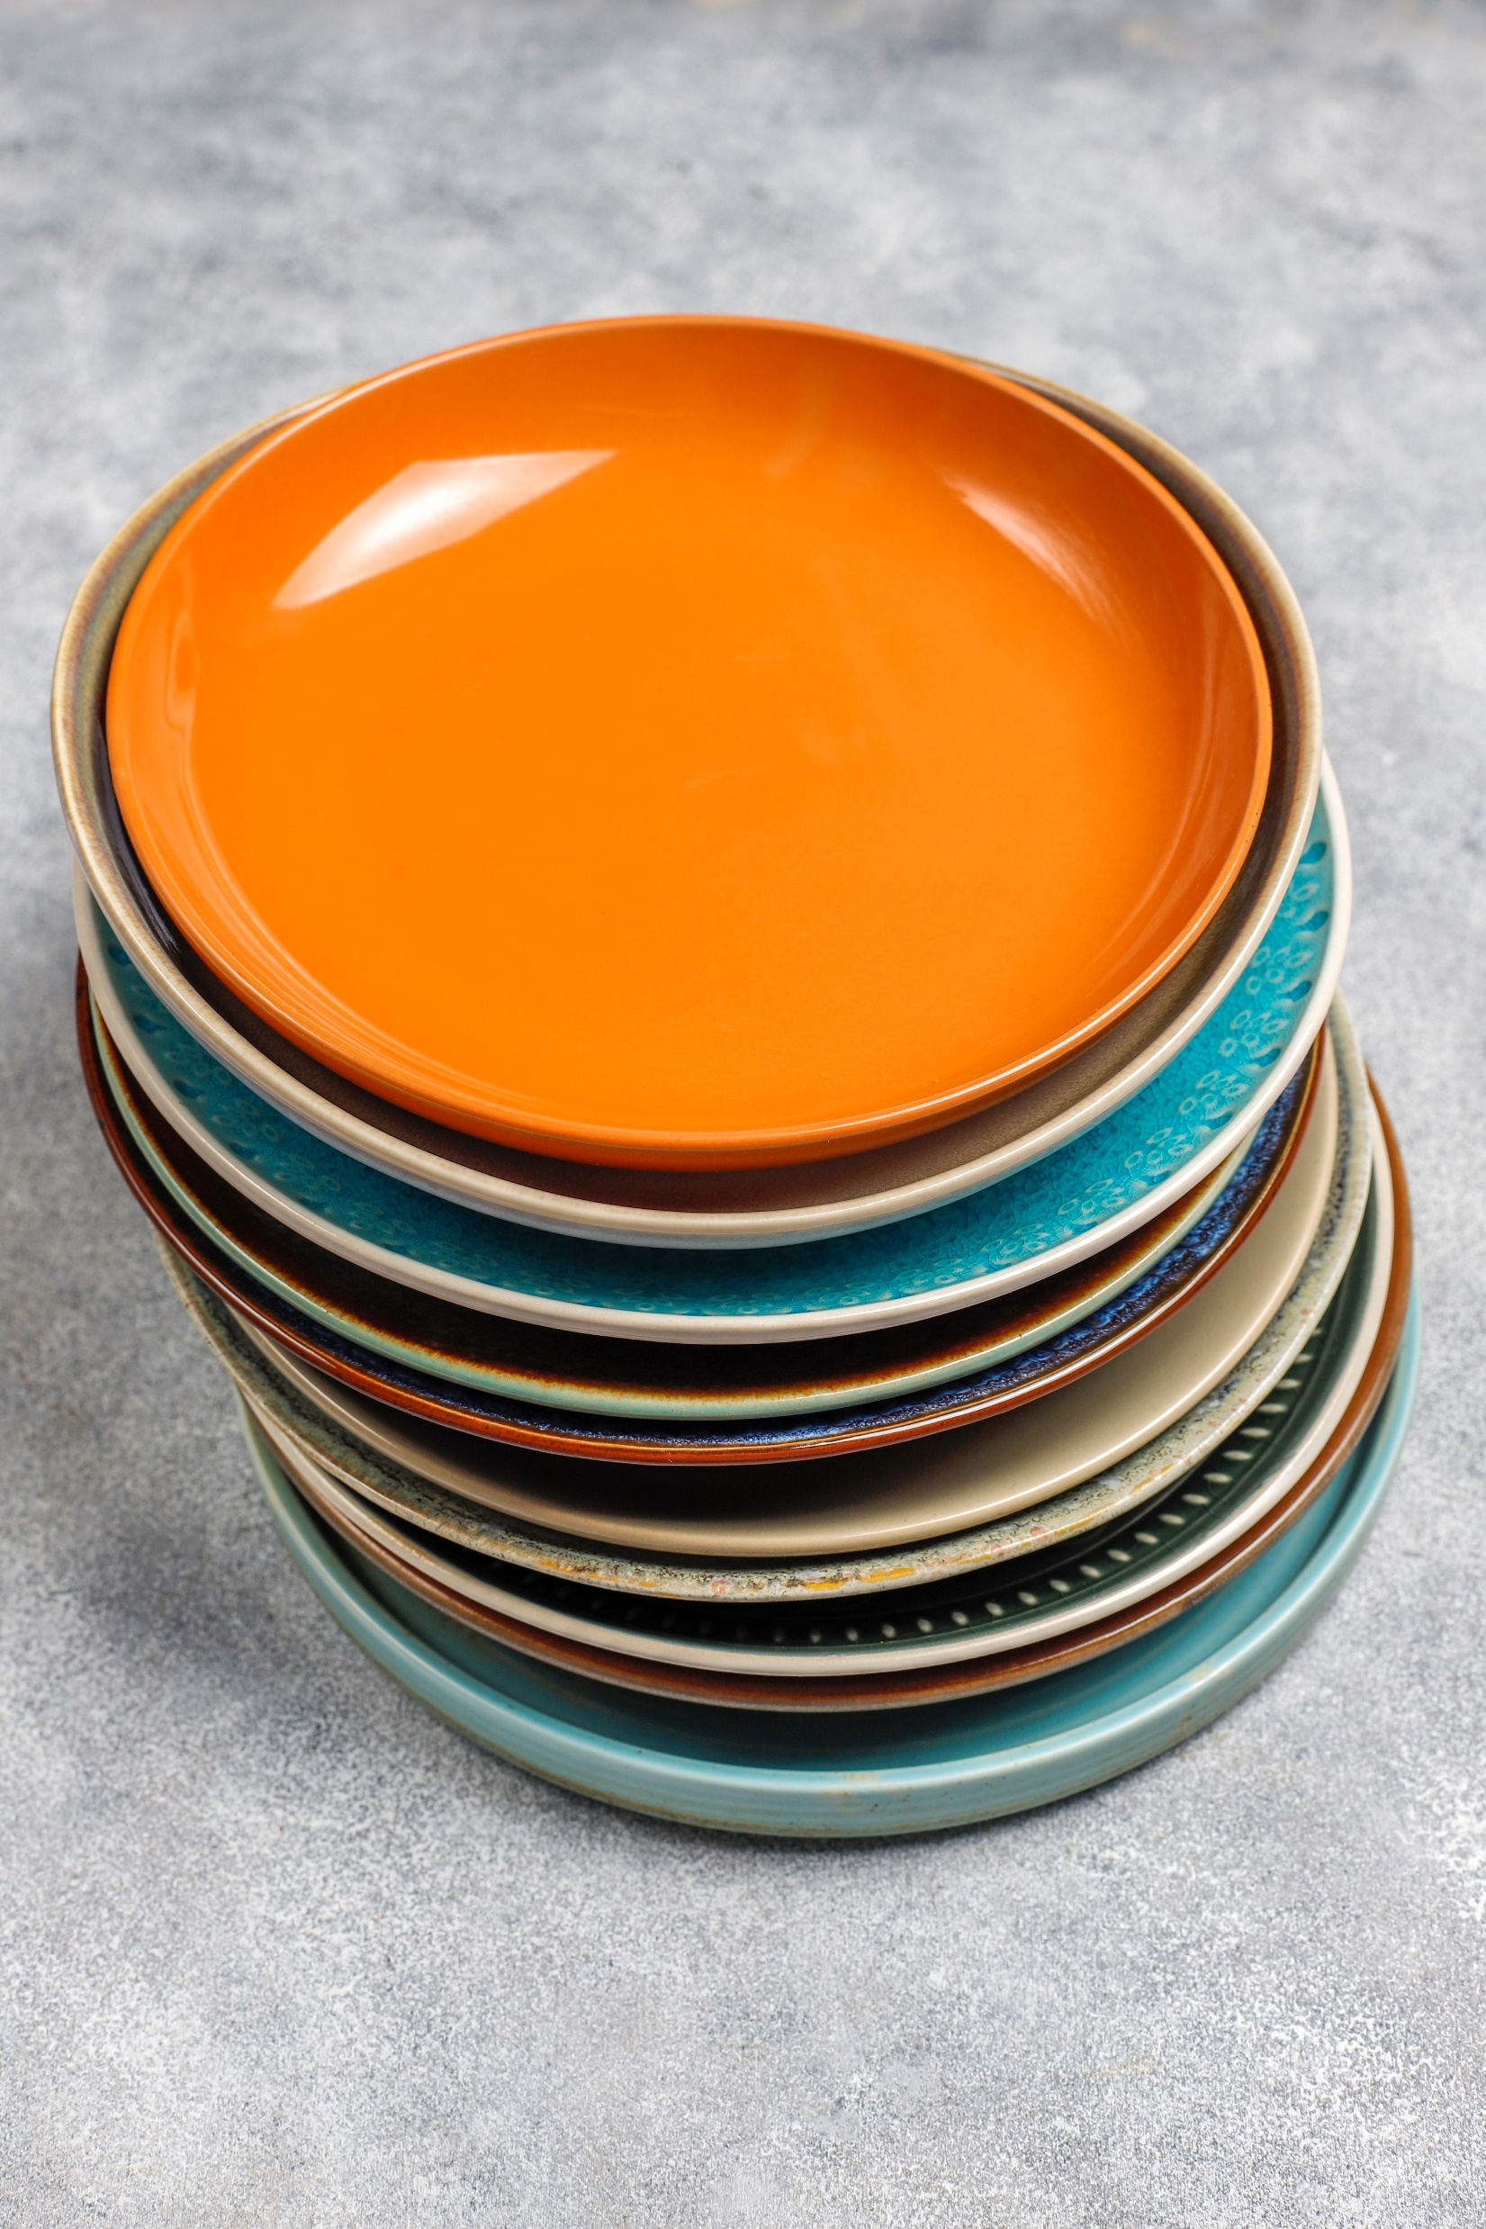
Stacks in Real Life
.
Example: Your Mom’s Dish Stack
You can think of the stack data structure as the pile of plates on top of another
Other Real-Life Stacks:
Back and Forward buttons in a web
Undo and Redo functionality in editors
Memory management
Expression conversion

Slide 8
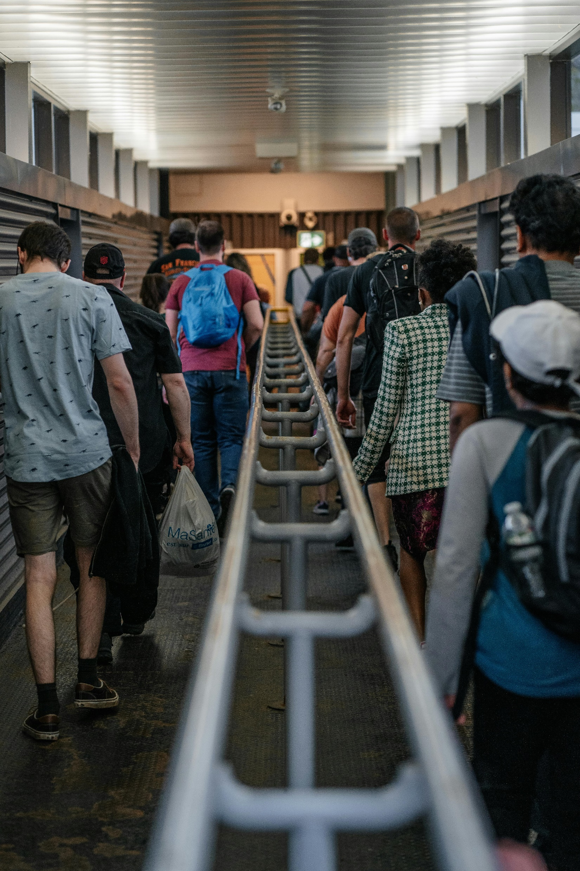
Queues in Our World
Example: The Biryani Queue**
Imagine you’re at Star Kabab, waiting for biryani. The line is long, and it’s “First In, First Out” (FIFO)—you can’t just jump ahead, no matter how much you dream of it. This is a queue.
Where Else Do We See Queues?
Waiting for a CNG.
The customer service
Job scheduling
Call centre management

Slide 9

Trees in Daily Decisions
Example: Family Tree Drama**
Every family gathering in Bangladesh feels like navigating a tree. The grandparents are the root, and everyone else branches out, with cousins coming out of nowhere to steal the spotlight!
Where Else Do We See Trees?
Trying to decide what to eat for lunch: First you think "biryani or khichuri," then it branches into "mutton or chicken."
The structure of your file storage, if you’re organized (or trying to be).

Slide 10
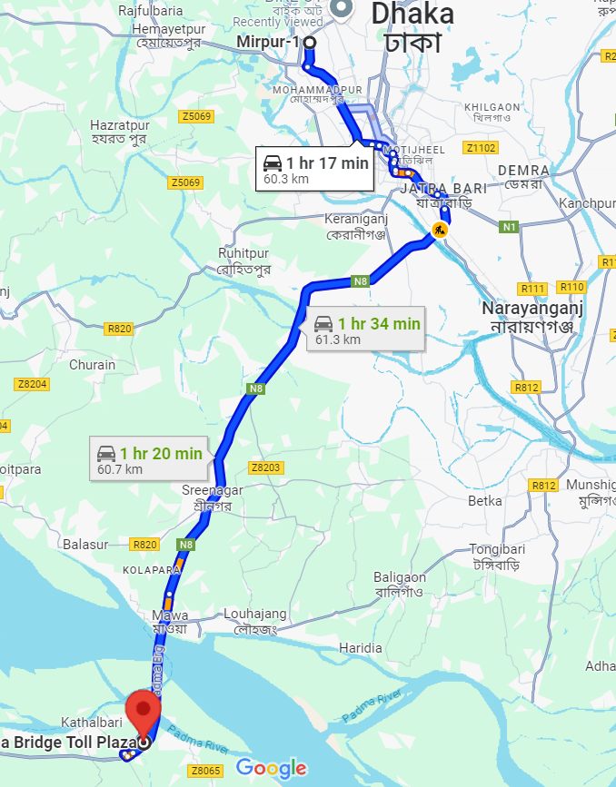
Graphs in Daily Navigation
Example: Motorcycle Ride to Padma Bridge
Imagine you’re riding from Mirpur to Padma Bridge. Each road is a node, and the roads connecting them are edges of a graph. You're trying to find the shortest path, but Dhaka traffic adds some exciting twists and turns.
Graphs are Everywhere:
In Google Maps when it avoids your favorite jam-packed route.
In friendships—you know, those “friend-of-a-friend” connections (who might owe you money).

Slide 11


Whether it’s organizing your to-do list, dodging traffic, or managing family gatherings, data structures are all around us.
Next time you’re stuck in traffic or deciding what to eat, just remember—you’re using a data structure without even realizing it!

Slide 12

Thank You!!
We are looking for question ??

